Slide 1
“Economic aspects of global warming in a post-Copenhagen environment” by William D. Nordhaus
Notes:
Image source: artist unknown, taken from a Sierra Club grassroots organizing manual.

Slide 2
Nordhaus is a distinguished economist with significant leadership experience in academia and public policy
Notes:
Image source (Nordhaus and book cover) : http://www.salon.com/2013/10/30/william_nordhaus_smoking_can_teach_us_about_climate_change/
Image credit (Nordhaus and book cover): Michael Marsland/Yale University
Image source (logos): from each institution’s website
Nordhaus’ website: http://www.econ.yale.edu/~nordhaus/homepage/
Brief Bio
- born in Albuquerque, New Mexico, USA
- distinguished professor of Economics at Yale University where he has taught since 1967, also teaches in Yale’s School of Forestry & Environmental Studies
- a prolific writer on a wide range of economic topics including energy and climate issues: 22 books, 158 journal publications, and 99 other kinds of publications (testimony, reports, working papers, etc.)
- member of the President’s Council of Economic Advisers under President Jimmy Carter (1977-1979)
- Chair of the Federal Reserve Bank of Boston’s Board of Directors (2014-), member since 2008
- President of the American Economic Association (2014-15)
- 2006 Award for “Publication of Enduring Quality,” Association of Environmental and Resource Economics for Managing the Global Commons (MIT Press, 1994)
- “Author of the D(ynamic)ICE and R(egional)ICE models of the economics of climate change, which have been widely used in research on studies of climate-change economics and policies.”

Slide 3
This is an analytical paper based on original modeling to describe climate and economic outcomes under different policy scenarios
Prescriptive
Optimal outcome (economic efficiency)
Descriptive
Copenhagen Accord as context and content
Predictions based on various policy scenarios
Causality analyzed using Integrated Assessment Model
Notes:
Nordhaus’ creation of an optimal policy scenario may make it seem that this article is prescriptive, but that’s not really his intention. He refers to it as “unrealistic”, and includes it not to make a normative judgement per se but to have a benchmark for comparing the economic efficiencies of other policy scenarios. Another useful comparison is with other models and what they consider to be optimal, both in terms of inputs and outputs.
This article is analytical, which means it is descriptive – using data to inform what is the current situation and then modeling to describe possible future scenarios.
Go through the descriptive categories…
Copenhagen Accord: established a ceiling on climate change in terms of the change in global average temperature, no more than a 2 degrees Celsius increase from the 1900 average. Keep in mind that we’ve already gone up by about 1 degree. Even though the agreement was established in 2009, I don’t think there has been any real progress.
Of course, Nordhaus was writing in 2010 and wanted to compare the climate and economic outcomes achieved under different policy scenarios. One of the unique contributions from this article is analyzing the outcomes of catastrophic climate change defined by a situation where this is no climate policy.

Slide 4
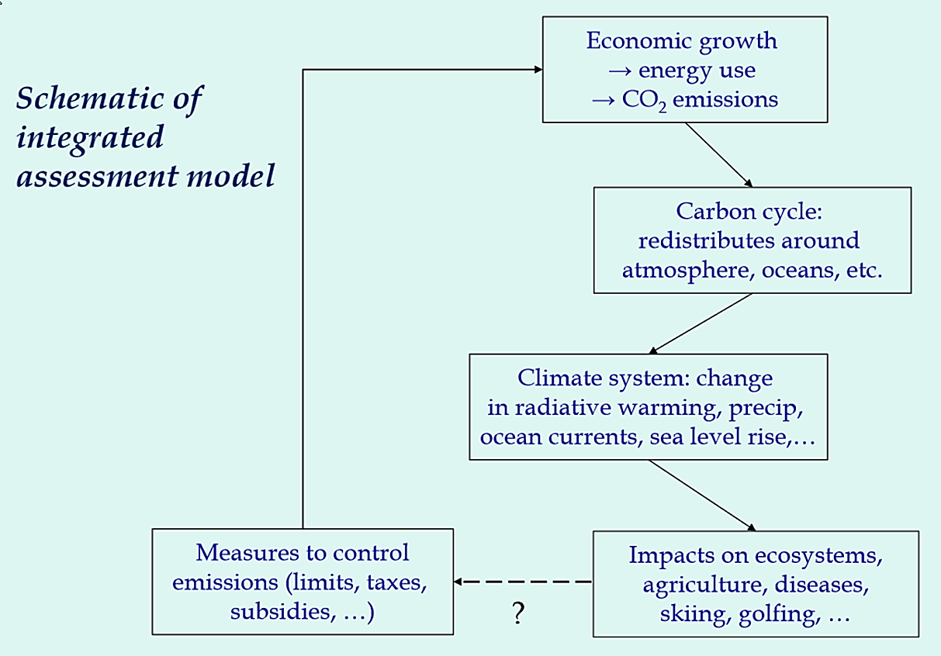
Nordhaus’ RICE-2010 model is used to analyze the Copenhagen Accord and compare that against optimal, baseline (no policy), and temperature-limited policy scenarios
Economic
Sectors
Geophysical
Sectors
Regional Integrated model of Climate and Economy

Slide 5
The RICE model creates simplified assumptions based on more complex and dynamic economic and climate models
INPUTS
OUTPUTS or OUTCOMES
12 world regions
Economic and geophysical sectors
Five different policy scenarios
CO₂ emissions
Atmospheric concentrations of CO₂
Changes in global average temperature
Carbon prices
Net costs and benefits
Notes:
Economic Sectors
- Regional characterizations:
* each region is assumed to produce a single commodity which can be used for consumption, investment, or emissions reduction.
* each region is endowed with an initial stock of capital & labor, and with an initial & region-specific level of technology.
- Output is measured in terms of GDP
- Population growth & technological changes are considered exogenous (outside influence) in the baseline model, whereas output is determined by optimizing the flow of consumption over time; output is determined using a Cobb-Douglas production function with capital, labor, and carbon-energy as inputs.
- Technological change takes 2 forms:
* economy-wide tech. change: Hicks-neutral (FOLLOW UP QUESTION, what does Hicks-neutral mean exactly?)...total factor productivity from sustainability
* carbon-saving tech. change: modeled as reducing the ratio of CO2 emissions to carbon-energy inputs
- Energy-related parameters are based on historical data on CO2 emissions and GDP (1960-2008).
* The model uses a cost function of CO2 emissions reductions based on national and regional models from the IPCC and the Energy Modeling Forum 22
* Backstop technology - what is it exactly, why is it so expensive, why does it take so long to become competitive with carbon fuels?
- The supply curve allows for limited (though large) long-run supplies of carbon fuels; in the optimal-growth framework, energy resources are efficiently allocated across time implying that low-cost carbon resources have scarcity prices ("Hotelling rents") and carbon energy prices rise over time.
* FOLLOW UP QUESTION: supply of what exactly? the single commodity of each region?
* Solutions of a multi-country, general equilibrium model pose major challenges in modeling, which were solved/modified by setting weights to each region's welfare (each region's weights are the region's shares of the global stock in a given period.
Geophysical Sectors
- This part of the model (within the larger model) has a number of relationships that link together the different factors affecting climate change, such as:
* simplified relationships to capture CO2 emissions, a carbon cycle, radiative forcings, a simple climate model, and regional climate-damage relationships...each of which is drawn from more complex and dynamic models
- Emissions include all GHG emissions although they are primarily CO2 emissions
* endogenous emissions in the RICE model are: industrial CO2 emissions
* exogenous emissions in the RICE model are: CO2 emissions from land use changes, non-CO2 GHGs, and sulfate aerosols
* CFCs are ignored here because they are beyond the scope of UNFCCC
- Climate change is represented by global mean surface temperatures...why not regional ones? (FOLLOW UP QUESTION)
- Damages: determined as a function of temperatures, SLR, and CO2 concentrations; these are region-specific
- Catastrophic climate change is included in this study based on recent studies; economic costs of catastrophe are included in the damage estimates; no precise tipping point was set however due to the unreliability of such figures
Policy Scenarios
Five different international policy scenarios are examined:
(1) Baseline: no climate policies are adopted
(2) Optimal: climate policies maximize economic welfare, with full participation by 2100 and no climate constraints (what does that mean exactly)
(3) Temperature limited: optimal policies are undertaken to ensure no greater than a 2 degree C increase (from 1900 average)
(4) Copenhagen Accord: rich countries implement deep emission cuts similar to those in current US proposals (Waxman-Markey?); developing counties join 20-50 years later
(5) Copenhagen Accord, rich-only: same as #4 except developing nations join starting in 2100
Optimal policy scenario: assumes the most efficient climate policies, efficiency involving a balancing of costs of abatement and the benefits of reduced climate damages
* this scenario is unrealistic but can serve as a benchmark against which to compare other scenarios
Temperature-limited policy scenario: similar to optimal scenario but with the added climate constraint (temperature)
* Rich countries - US, EU, Russia, Japan, and other nations

Slide 6
The Temperature-limited and Copenhagen Accord policy scenarios lead to the greatest cuts in projected CO₂ emissions
Notes:
Image Source: Nordhaus 2010
Note that the Copenhagen Accord-rich only graph shows a steady rise in projected CO2 emissions indicating that developing nations need to cut their emissions too.

Slide 7
All policy scenarios lead to a rise in atmospheric concentrations of CO₂ with the smallest increase under the Temperature-limited case
Notes:
Image Source: Nordhaus 2010
Note that the Copenhagen Accord and Optimal policy scenarios lead to a similar, if not the same, rise in projected atmospheric concentrations of CO2.
Note that this is specifically concentration of CO2 and not CO2-equivalent

Slide 8
The Copenhagen Accord policy scenarios fail to meet the 2 ºC limit due to the timing or lack of participation by developing countries
Notes:
Image Source: Nordhaus 2010
All policy scenarios lead to a rise in global temperature with the smallest increase under the Temperature-limited case, followed by the Copenhagen Accord scenario and then the Optimal scenario.

Slide 9
The current global average price of carbon is extremely low compared to the prices under different climate policy scenarios
Notes:
Image Source: Nordhaus 2010
Carbon prices under the 2 Copenhagen Accord scenarios are extremely low in the short term due to gradual introduction of the policy and incomplete participation.

Slide 10
Net benefits of climate policy interventions are substantial in the long-run, but net costs dominate in the short-run

Slide 11
While the RICE model can help inform public policy, it cannot overcome key obstacles in the political and economic systems
A classic public good | Intertemporal tradeoff | Spatial asymmetry | Policy bias
A strategic relationship between costs and benefits | Climate policies require high upfront costs with benefits of reduced damages in the distant future | Differences between costs and benefits between regions of the world, especially in the short-run | Kyoto Protocol and Copenhagen regimes favor cap-and-trade scheme
Nash equilibrium which leads to free riding | “A level of political maturity that is rarely observed” | Further incentive to move toward the Nash equilibrium | Efficiency gains of a cap-and-trade scheme are “illusory” but more politically viable than a carbon tax
Notes:
The models present unrealistically smooth picture of the functioning of the economic and political systems.
Nash equilibrium: from game theory, non-cooperative behavior, each nations reduces emissions but only up to the point that they themselves benefit
Intertemporal: Costs>benefits by 5 times until 2055 and then Benefits>costs by 4 times…delayed payoffs are further incentive for Nash, non-cooperative equilibrium
Spatial: the regions asked to make the most dramatic cuts in emissions are the ones in which costs outweigh benefits, at least in the short-run
Policy: self-explanatory

Slide 12
Is this a case where economics points us “to do the obviously wrong thing”? (Ackerman and Heinzerling 2004)

